Slide 1
Data Structures and Algorithms INFO-3135
Tracing Iterative Sort Algorithms
(Selection, Bubble, Insertion)

Slide 2
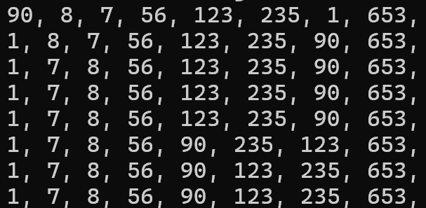
Selection Sort Trace
Unsorted list
Selection Sort:
Find minimum from unsorted
Swap with first unsorted element
Repeat
Sorted list

Slide 3
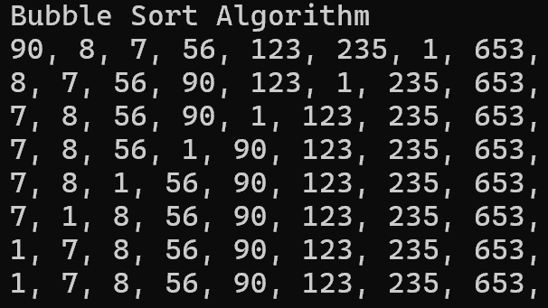
Bubble Sort Trace
Unsorted list
Bubble Sort:
Compare adjacent elements
Swap if needed
Repeat
Sorted list

Slide 4
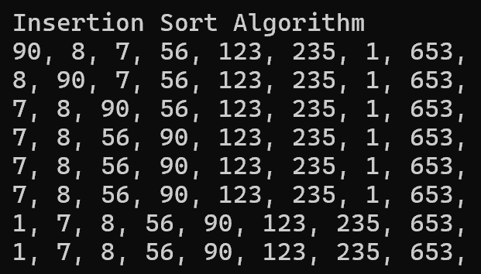
Insertion Sort Trace
Unsorted list
Insertion Sort:
Consider first element is sorted
Next element is stored as a key
Repeat shifting elements right with current element > key
When current element < key, copy key into current element
Repeat
Sorted list

Slide 5
Insertion Sort Trace
8 is key - 90 is shifted right
7 is key - 8 and 90 are shifted right
56 is key - 90 is shifted right
123 is key - no shifts
235 is key - no shifts
1 is key - 7, 8, 56, 90 123, 235 are shifted
653 is key - no shifts

